Slide 1
Simka Fast kmer-based method for estimating the similarity between numerous metagenomic datasets
Gaëtan BENOIT
PHD student - ANR Hydrogen
GenScale bioinformatics research group
IRISA/INRIA – Rennes - FRANCE
24/09/2015

Slide 2
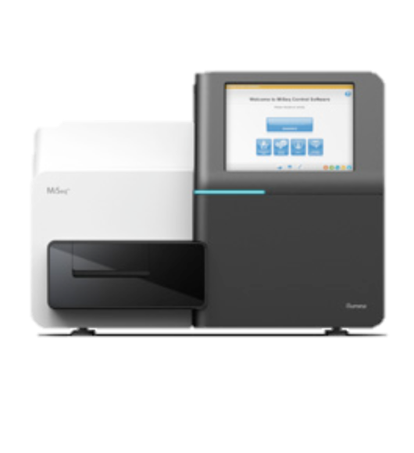
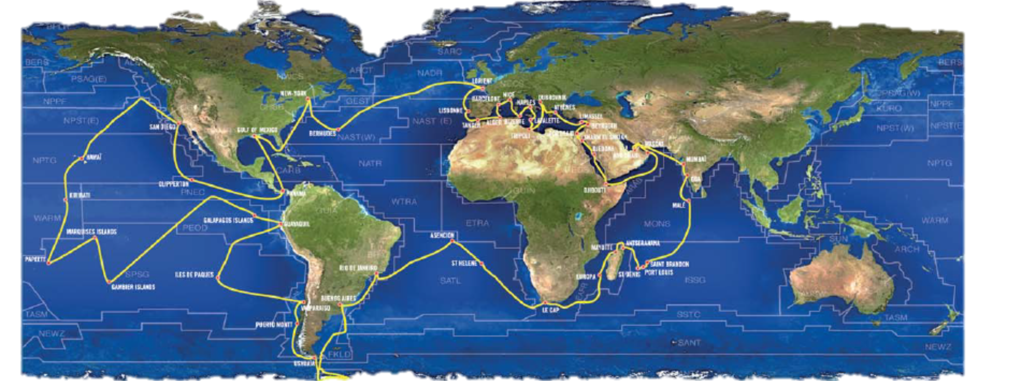
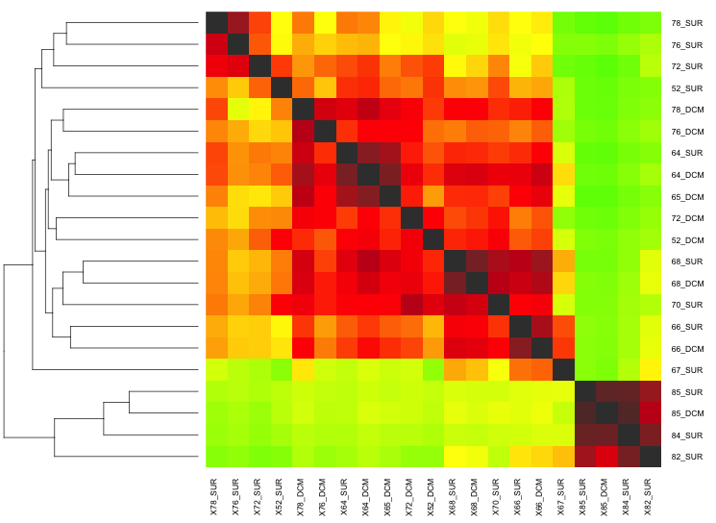
Context
Tara Oceans
200 sampling sites
N metagenomic samples
Whole genome sequencing
De novo
comparative
metagenomics
fasta
fasta
…
fasta
N MetaG datasets
Tara Oceans
> 1000 datasets
> 100 millions reads each
Similarity heatmap N²

Slide 3
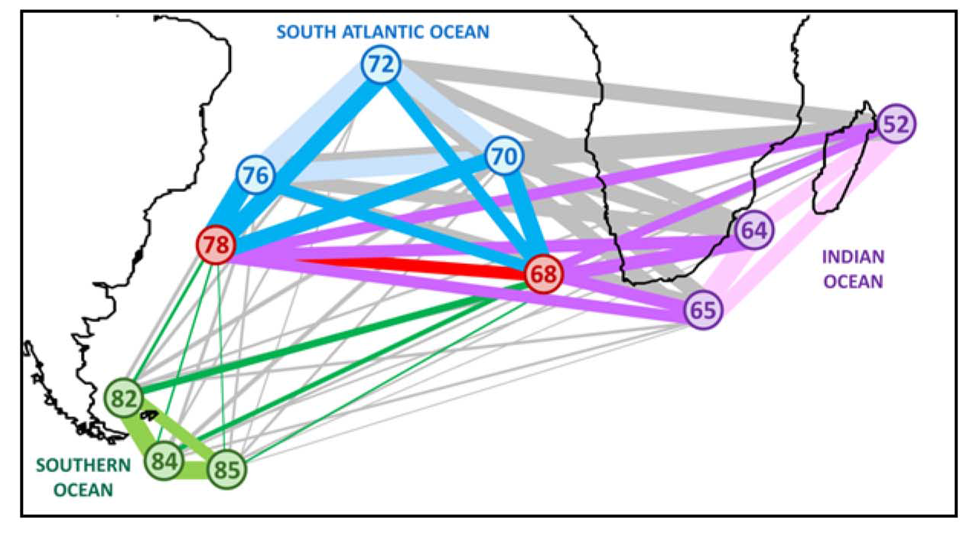
De novo comparative metagenomics
Sea water
< 5% assembled reads
< 10% known species
Compare environmental data and genomic contents
Environmental characteristics of Agulhas rings affect interocean
plankton transport. Villar et al. Science 2015
Similarities on
Barcodes
WGS
→same conclusions

Slide 4
Similarity between 2 samples
Idea: Similarity is given by the size of the intersection
A
B
100M reads
Would require months of computation
specific
✖
specific
Intersection = number of similar reads
Similar: alignment score > 90%
(Blast-like approaches, all-vs-all sequence alignment)

Slide 5
State of the art
Commet (Maillet et al. IEEE BIBM 2014)
“similar”: share at least t non-overlapping kmers (words of size k)
Example: t=2:
Computes one intersection in few hours
Alignment free method
Only indexing and querying kmers
ACTGACT
CGTTAGT
ACTGACT
CGTTAGT
Does not scale on large metagenomic
projects :
N(N-1) comparisons
specific
specific
✖
A
B

Slide 6
Simka: comparing numerous datasets
New representation of datasets
Not viewed as a read-set anymore
But as a bag of its overlapping kmers
read-set
all
occurrences
of kmers
kmer-bag
reads
AAAACG
AAACGA
AACGAA
...
AAAACG
Output of kmer counting algorithm
read
AAAACGAAAACG
AAAACG
AAACGA
AACGAA
...
AAAACG
Kmers
(k=6)
In practise k > 30
AAAACG 2
AAACGA 1
AACGAA 1
...
Distinct kmers
with their abundance

Slide 7
Partition
Sort
Count
fastq
fastq
A
B

Slide 8
Simka: comparing numerous datasets
New similarity function
Pairwise similarity measure based on shared kmers
Abundance-based Jaccard similarity
abundance
shared
kmers
specific
We need
Fast kmer counting algorithm
Compute faster the N(N-1) comparisons
specific
With :
Abundance of w in A
Kmer-bag
A
Kmer-bag
B
AAAAAA 4
TTTAAA 1
TTTTTT 1
AAAAAA 1
CCCCCA 1
CCCCCT 2
8

Slide 9
Multiset kmer counting
Count the kmers of N datasets simultaneously
Based on KMC2 algorithm (Deorowicz et al. Bioinformatics 2015)
Available in GATB library (Drezen et al. Bioinformatics 2014)
fasta
fasta
fasta
…
fasta
A
B
C
N
GATB - DSK
For each distinct kmer
 | A | B | C | … | N
ACGATC | 0 | 4 | 52 | … | 0
Its abundance in
each dataset
We can now count the kmers of large datasets quickly
Compute all the intersections simultaneously

Slide 10
Simka algorithm
Example with 3 datasets on Abundance-based Jaccard similarity

Slide 11
Simka algorithm
Example with 3 datasets on Abundance-based Jaccard similarity
Kmer shared by A, B and C
For each pair(i, j)
 | A | B | C
ACGATC | 4 | 2 | 8
A
B
A
C
B
C

Slide 12
Simka algorithm
Example with 3 datasets on Abundance-based Jaccard similarity
Kmer shared by A, B and C
For each pair(i, j)
If kmer is shared Ni > 0 and Nj > 0
 | A | B | C
ACGATC | 4 | 2 | 8
A
B
A
C
B
C

Slide 13
Simka algorithm
Example with 3 datasets on Abundance-based Jaccard similarity
Kmer shared by A, B and C
For each pair(i, j)
If kmer is shared Ni > 0 and Nj > 0
Update intersection n[i,j] += Ni + Nj
 | A | B | C
ACGATC | 4 | 2 | 8
+4
+2
A
B
A
C
B
C

Slide 14
Simka algorithm
Example with 3 datasets on Abundance-based Jaccard similarity
Kmer shared by A, B and C
For each pair(i, j)
If kmer is shared Ni > 0 and Nj > 0
Update intersection n[i,j] += Ni + Nj
Update union u[i,j] += Ni + Nj
 | A | B | C
ACGATC | 4 | 2 | 8
+4 +2
+4
+2
A
B
A
C
B
C
AJ(A,B) = 6/6 = 1

Slide 15
Simka algorithm
Example with 3 datasets on Abundance-based Jaccard similarity
Kmer shared by A, B and C
For each pair(i, j)
If kmer is shared Ni > 0 and Nj > 0
Update intersection n[i,j] += Ni + Nj
Update union u[i,j] += Ni + Nj
 | A | B | C
ACGATC | 4 | 2 | 8
+4 +2
+4 +8
+4
+2
+4
+8
A
B
A
C
B
C
AJ(A,B) = 6/6 = 1
AJ(A,C) = 12/12 = 1

Slide 16
Simka algorithm
Example with 3 datasets on Abundance-based Jaccard similarity
Kmer shared by A, B and C
For each pair(i, j)
If kmer is shared Ni > 0 and Nj > 0
Update intersection n[i,j] += Ni + Nj
Update union u[i,j] += Ni + Nj
 | A | B | C
ACGATC | 4 | 2 | 8
+4 +2
+4 +8
+2 +8
+4
+2
+4
+8
+2
+8
A
B
A
C
B
C
AJ(A,B) = 6/6 = 1
AJ(A,C) = 12/12 = 1
AJ(B,C) = 10/10 = 1

Slide 17
Simka algorithm
Example with 3 datasets on Abundance-based Jaccard similarity
Kmer specific to A
For each pair(i, j)
If kmer is shared Ni > 0 and Nj > 0
Update intersection n[i,j] += Ni + Nj
Update union u[i,j] += Ni + Nj
 | A | B | C
ACGATC | 6 | 0 | 0
+4+6 +2
+4+6 +8
+2 +8
+4
+2
+4
+8
+2
+8
A
B
A
C
B
C
AJ(A,B) = 6/12 = 0.5
AJ(A,C) = 12/18 = 0.66
AJ(B,C) = 10/10 = 1

Slide 18
Simka algorithm
Example with 3 datasets on Abundance-based Jaccard similarity
N(N-1)
Kmer specific to A
For each pair(i, j)
If kmer is shared Ni > 0 and Nj > 0
Update intersection n[i,j] += Ni + Nj
Update union u[i,j] += Ni + Nj
 | A | B | C
ACGATC | 6 | 0 | 0
+4+6 +2
+4+6 +8
+2 +8
+4
+2
+4
+8
+2
+8
A
B
A
C
B
C
AJ(A,B) = 6/12 = 0.5
AJ(A,C) = 12/18 = 0.66
AJ(B,C) = 10/10 = 1

Slide 19
Execution time
On 21 Tara samples, 2.1G reads, 210GB data
Commet (state of the art)
On cluster (one node)
A few weeks
Simka
On cluster (one node): 3h
Counting kmers: 75%
Update unions/intersections N(N-1): 25%
On standard computer: 10h
4 GB memory, 4 cores

Slide 20
Representation of similarity
Hierarchical
clustering
100% similar
Heatmap
40%
similar
A
B
14% similar
Asymmetry can shows
information about diversity

Slide 21
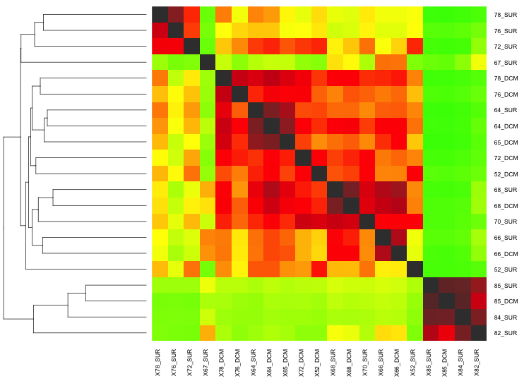
Results
Two things to compare with Commet
Heatmap
absolute similarity
Hierarchical clustering
relative similarity

Slide 22
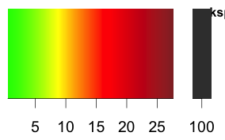
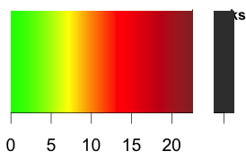
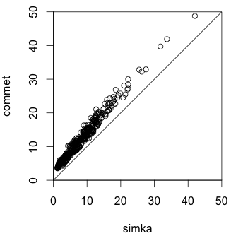
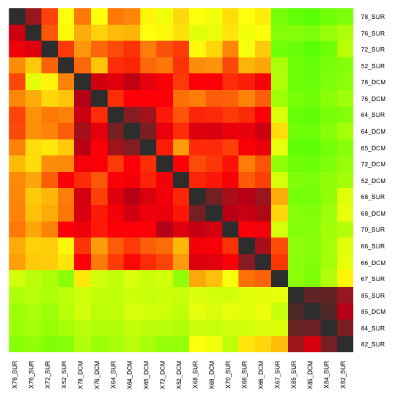
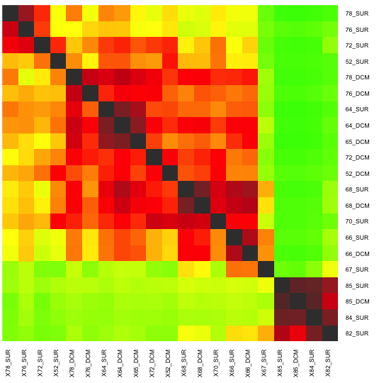
On 21 datasets from Tara Oceans
Commet (k=33)
Simka (k=31)
Compareads

Slide 23
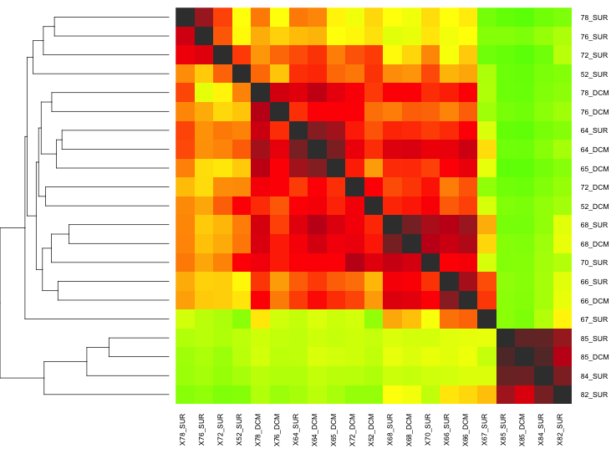
On 21 datasets from Tara Oceans
Commet (k=33)
Simka (k=31)

Slide 24
Other measures provided
Transform the abundance vectors to get new measures
From abundance to presence/absence
Filtering potentially erroneous kmers
Discard kmer if specific (D=1) and unique (Ni=1)
 | A | B | C
ACGATC | 0 | 4 | 2
 | A | B | C
ACGATC | 0 | 1 | 1
To boolean vector
Jaccard similarity:
 | A | B | C
ACGATC | 0 | 1 | 0
 | A | B | C
ACGATC | 0 | 1 | 1
 | A | B | C
ACGATC | 0 | 0 | 8
✖
✔
✔

Slide 25
Conclusion
Simka
New pairwise similarity functions based on shared kmers
Provides measures based on abundance and presence/absence
Results close to read-based methods
Fast and low memory thanks to the GATB library
Execution time (21 Tara samples, 2.1G reads, 210GB data)
Commet (state of the art): few weeks
Simka
On cluster: 3h
On standard computer: 10h
GATB
www.gatb.inria.fr
Simka
www.gatb.fr/software/simka

Slide 26
Perspectives
Add similarity measures well used in ecology (Ex: Bray Curtis)
Bootstrapping
Test the robustness of Simka
Are there differences between using 100M or 10M reads?
Provides similarity matrix with confidence intervals
Sim(A, B) = 23% ±0.6%
Add confidence levels to dendrogram
Simka Potara
For cluster and cloud
MapReduce model
Process huge amount of data
130 Tara samples (13G reads, 1.3TB data) compared in < 1 day
 | A | B | C
species | 0 | 4 | 2
 | A | B | C
kmer | 0 | 4 | 2

Slide 27
Acknowledgements
PHD Supervisor
---
Claire Lemaitre
Pierre Peterlongo
Dominique Lavenier
GATB devs
---
Erwan Drezen
Guillaume Rizk
Commet
---
Nicolas Maillet
Partners
----------------------------
INRA
---
Stéphane Robin
Sophie Schbath
Mahendra Mariadassou
Julien Chiquet
Julie Aubert
Sarah Ouadah
Emilie Lebarbier
CEA
---
Olivier Jaillon
Jean-Marc Aury
Eric Pelletier
Thomas Vannier
Founded
---
ANR Hydrogen

